Slide 1

Airbnb New York Analysis (2011 - 2019) : Data Analysis On Hospitality Industry
Name: Abhilash Kumar Dikshit
Student ID: 2702209
Course: MPS Analytics- ALY 6000
Campus: Vancouver, Canada

Slide 2
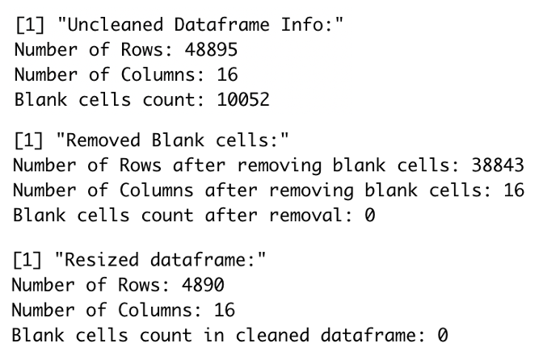

Airbnb New York Analysis (2011 - 2019)
Airbnb New York Analysis (2011 - 2019)
This dataset contains information about Airbnb host listings, neighbourhoods, price, minimum nights, review counts/rate and the availability throughout the year.
Limitations:
No data on customer stay duration, timeline, review score for each listing and no. of tourist attractions nearby.
Acknowledgements:
Dataset taken from Kaggle. This is a public dataset of Airbnb, and the original source can be found in their website.
Data Analysis Presented:
Part 1- Dataframe cleanup:
Sorted as per price
Removed blank cells
Resized the data frame to rows< 6000 and attributes> 8
Part 2- Created new attributes based on the data:
Extracted Year form column last_review
Added extra column Review_Year to identify number of reviews based on the room type from year 2011-2019.
Computed the mean and median for each of the variables.
Part 3- Data Storytelling:
Data storytelling using descriptive statistics and visualizations

Slide 3
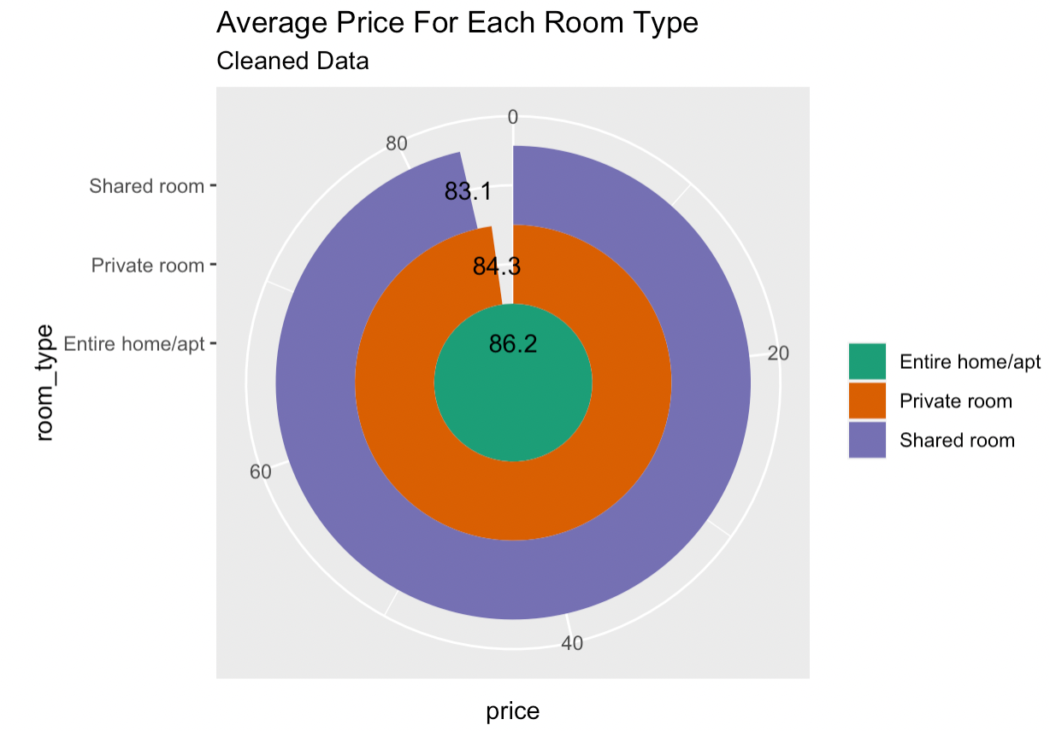
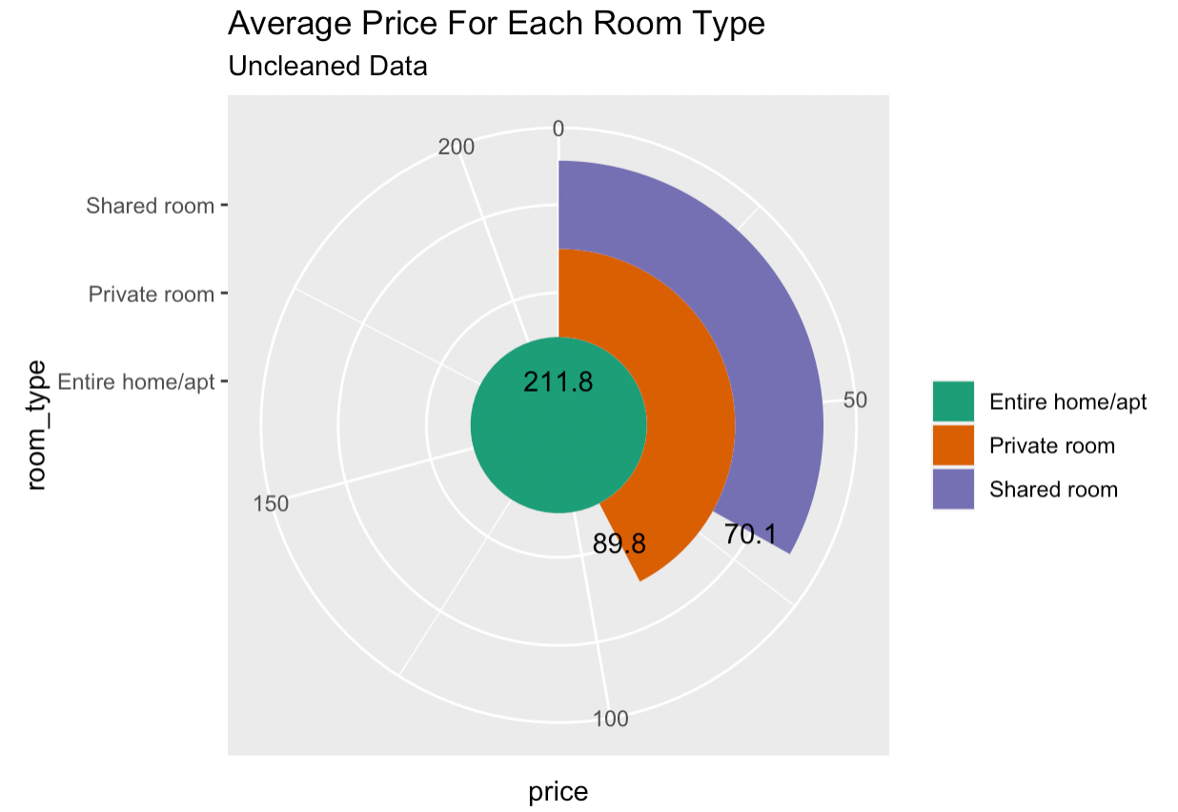
Uncleaned & Cleaned Dataset: Average Price For Each Room Type
Business Question:
What is the average cost for each room type and which area is the most expensive/cheap?
Analysis For Uncleaned Data:
a) Entire home/apartment average cost is 212 dollars
b) Private rooms average cost is 90 dollars
c) Shared rooms average cost is 70 dollars
Analysis For Cleaned Data:
a) Entire home/apartment average cost is 86 dollars
b) Private rooms average cost is 84 dollars
c) Shared rooms average cost is 83 dollars

Slide 4
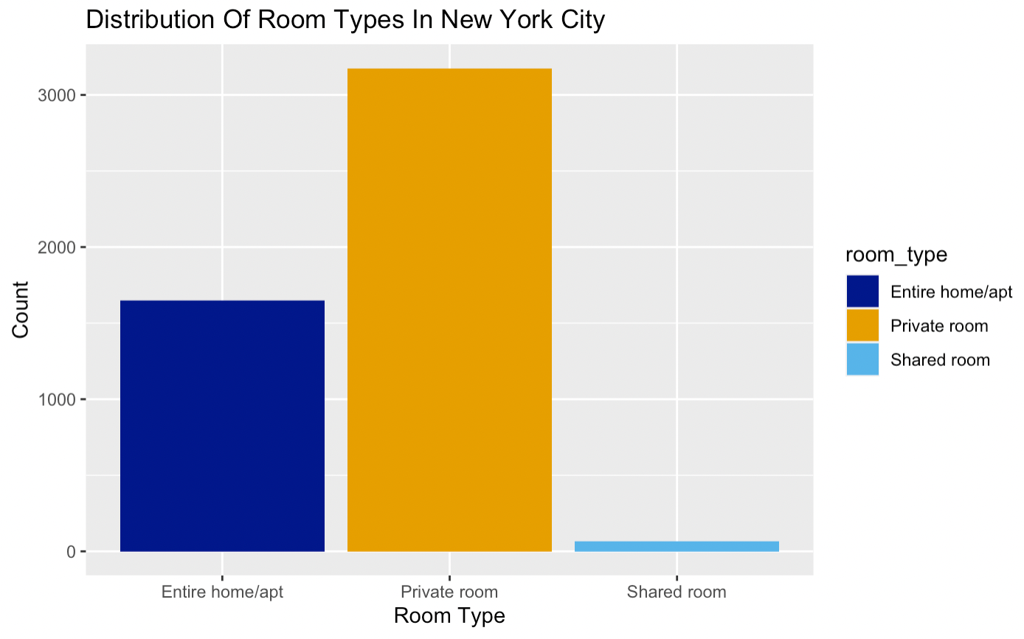
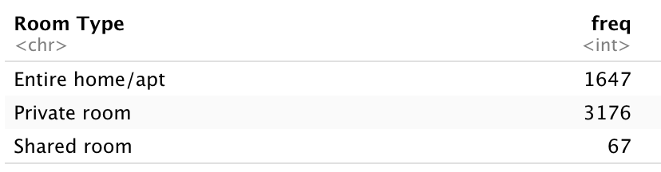
Show Popular Room Type In New York City
Business Question:
Describe the distribution of room type in New York city? Which is the most popular?
Analysis:
We have 3 room types in New York City, USA i.e., Entire home/apt, Private room and Shared room.
Customers prefer to book the private room type stay and it is the most popular as compared to Entire home or apartment and shared room types in New York city, USA as depicted in the plot.
Reason:
Vacation place
Business Travel
Entertainment Industry

Slide 5
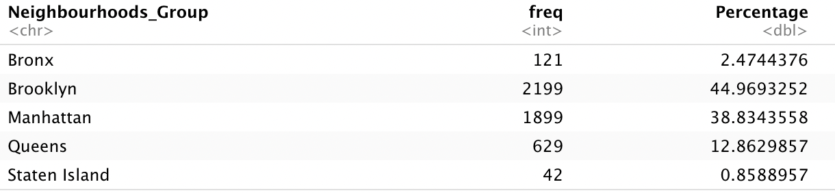
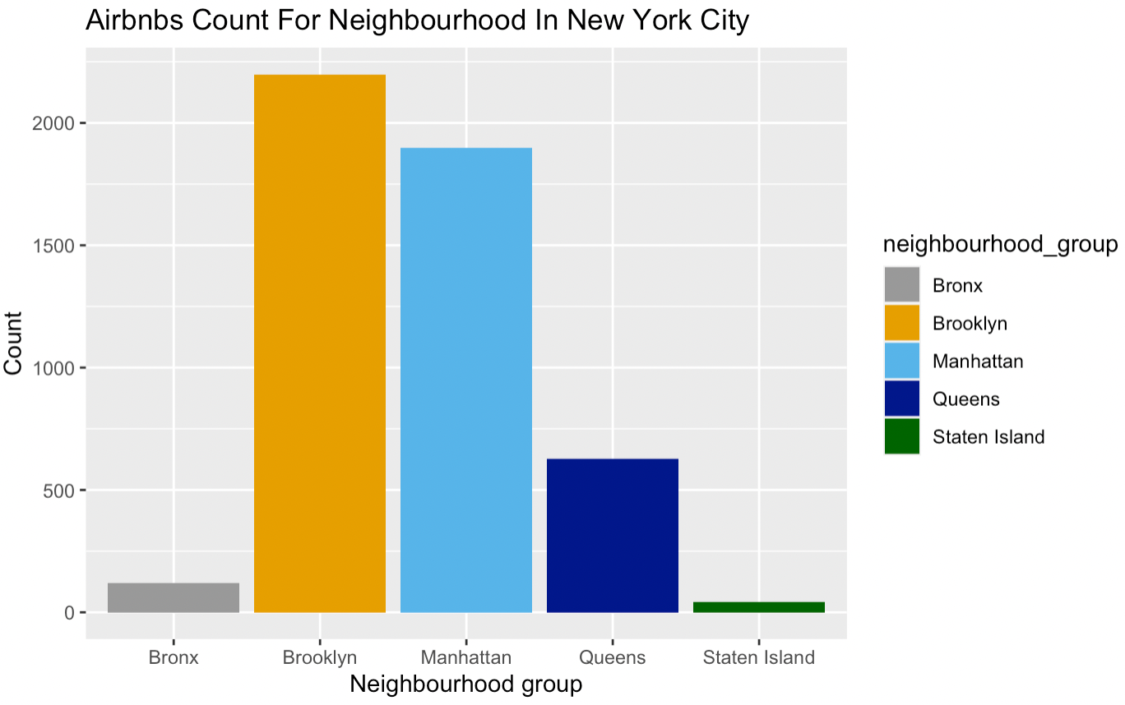
Neighborhood Groups & Percentage Of Airbnb’s
Business Question:
What is the distribution of the neighbourhood groups variable and percentage of Airbnb's located in each area?
Analysis:
We have differentiated the neighbourhood in 5 groups as shows in the given table.
Out of Bronx, Brooklyn, Manhattan, Queens, and Staten Island, the percentage of Airbnb's located in Brooklyn is 45% which is the highest among all whereas Manhattan is at 39% followed by Queens which is at 13%, Bronx at 2% and Staten Island is below 1%.
Reason:
Close by nature, parks and archeological sites.
Good weather and food.
Good commute and less traffic.

Slide 6
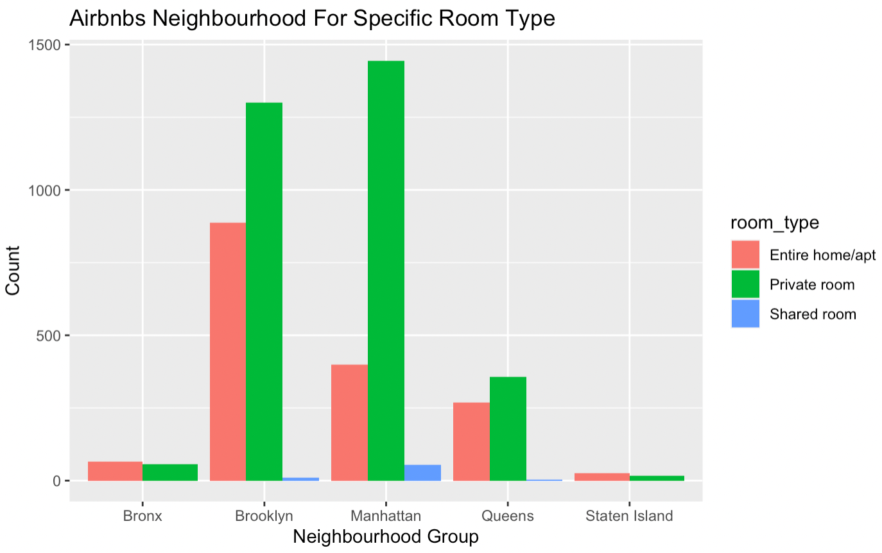
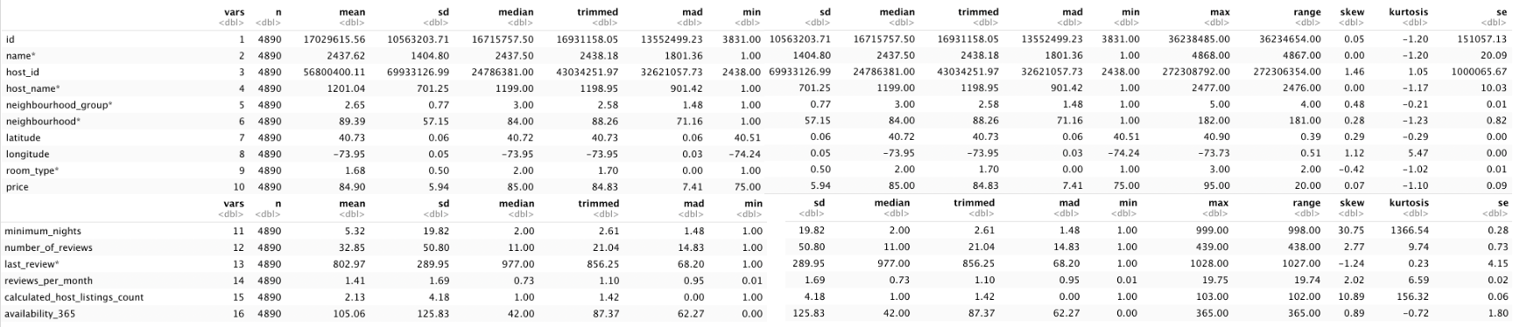
Distribution Of Neighborhood Group & Room Type
Business Question:
What is the distribution of the neighbourhood groups and room types located in each area?
Analysis:
Manhattan and Brooklyn have the most rooms in general. They have the most entire private room. Manhattan and Brooklyn are basically split up between private room and entire home/apartment. The three other places have little rooms in general.
Reason:
High demand of hotel industry.
Number of customer are high.
High lifestyle
Top company
executives and
business market.
Mean & Median

Slide 7
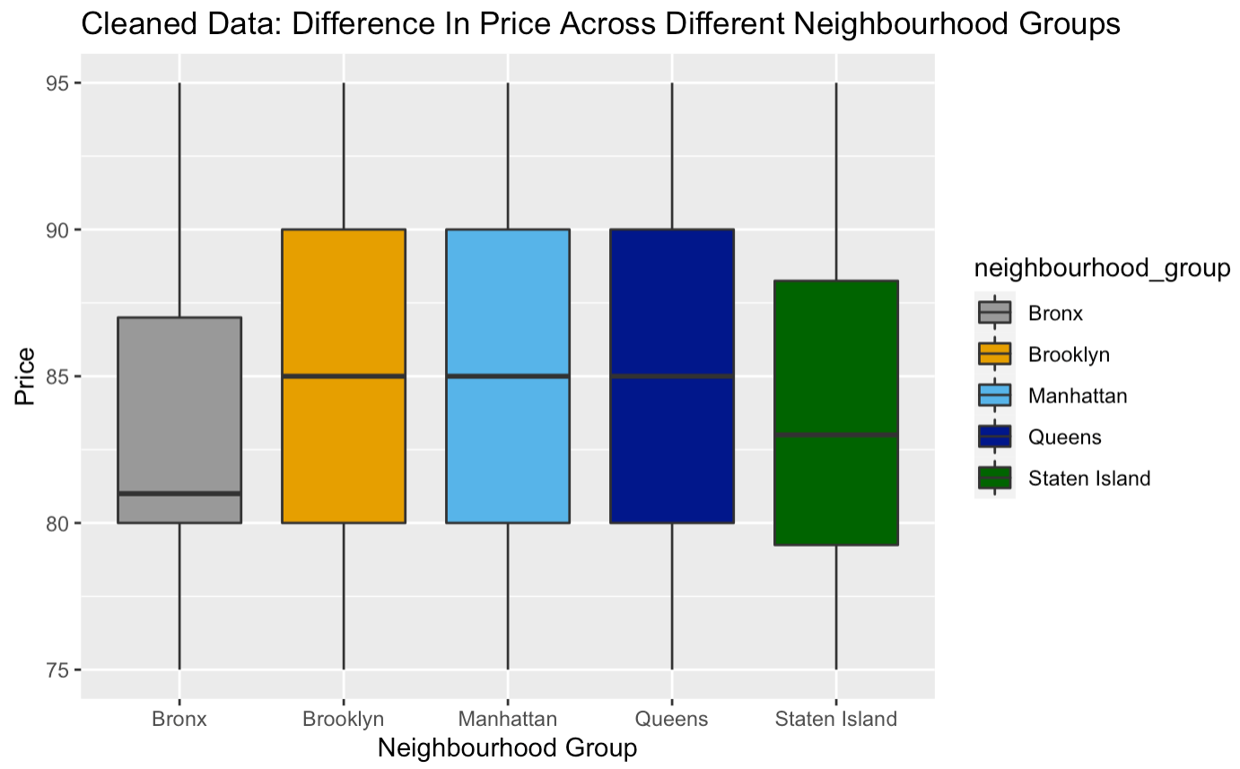
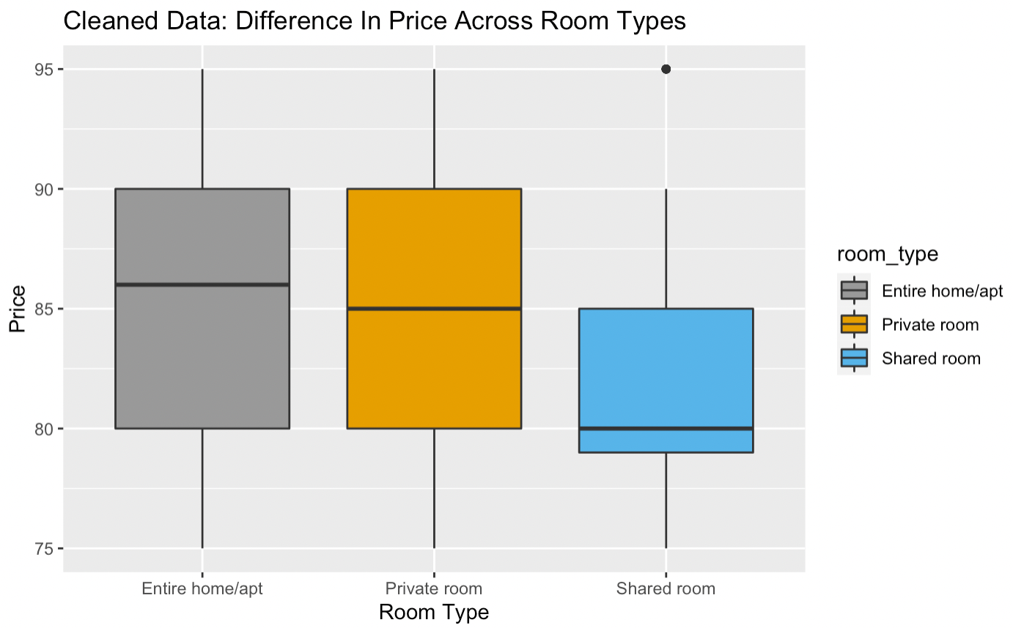
Price Comparison Across Different Neighborhood And Room Types
Business Question:
Is there a difference in price across different neighbourhood groups?
Analysis:
Brooklyn and Manhattan has the highest median price out of all of them i.e., 85. It also has the least number of outliers.
Bronx region has the lowest median price i.e., 82.
Business Question:
Is there a difference in price across different room types?
Analysis:
Entire home or apartment has the highest median price out of all of them i.e., 86. It also has the least number of outliers whereas Private room has 85 median price.
Shared room has the lowest median price i.e., 80.

Slide 8
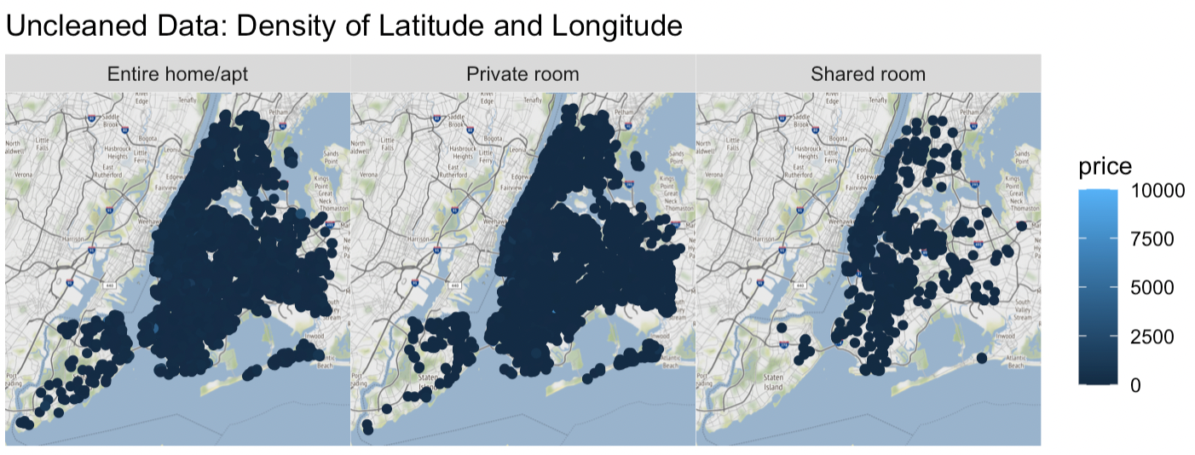
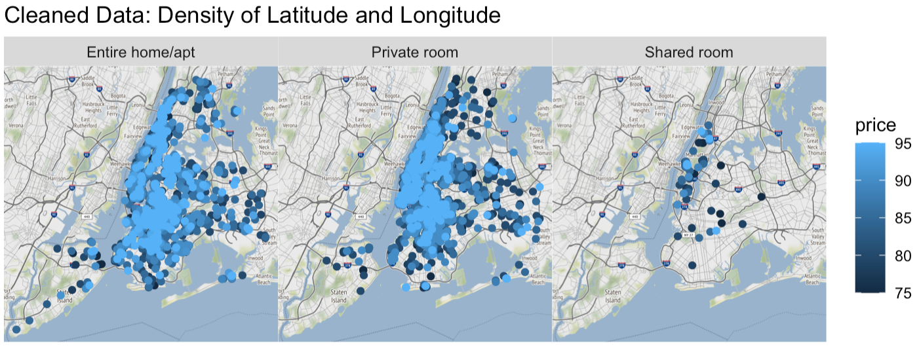
Latitude and Longitude Density For Specific Room Types As Per Price
Business Question:
How much is the price density as per room types across a region?
Analysis:
For Uncleaned Dataset, there is lesser density of price in New York city due to lower booking rates. When compared the same to Private room and Entire home or apartment, we see the graph gets denser. However, we need further analysis to get the correct data as it’s an uncleaned data set.
For Cleaned Dataset, we can clearly analyse the density of prices across all 3 room types and Private rooms has the highest denser plot in the region.
Reason:
Good hospitality service and corporate discounts.
Better options on room availability.

Slide 9
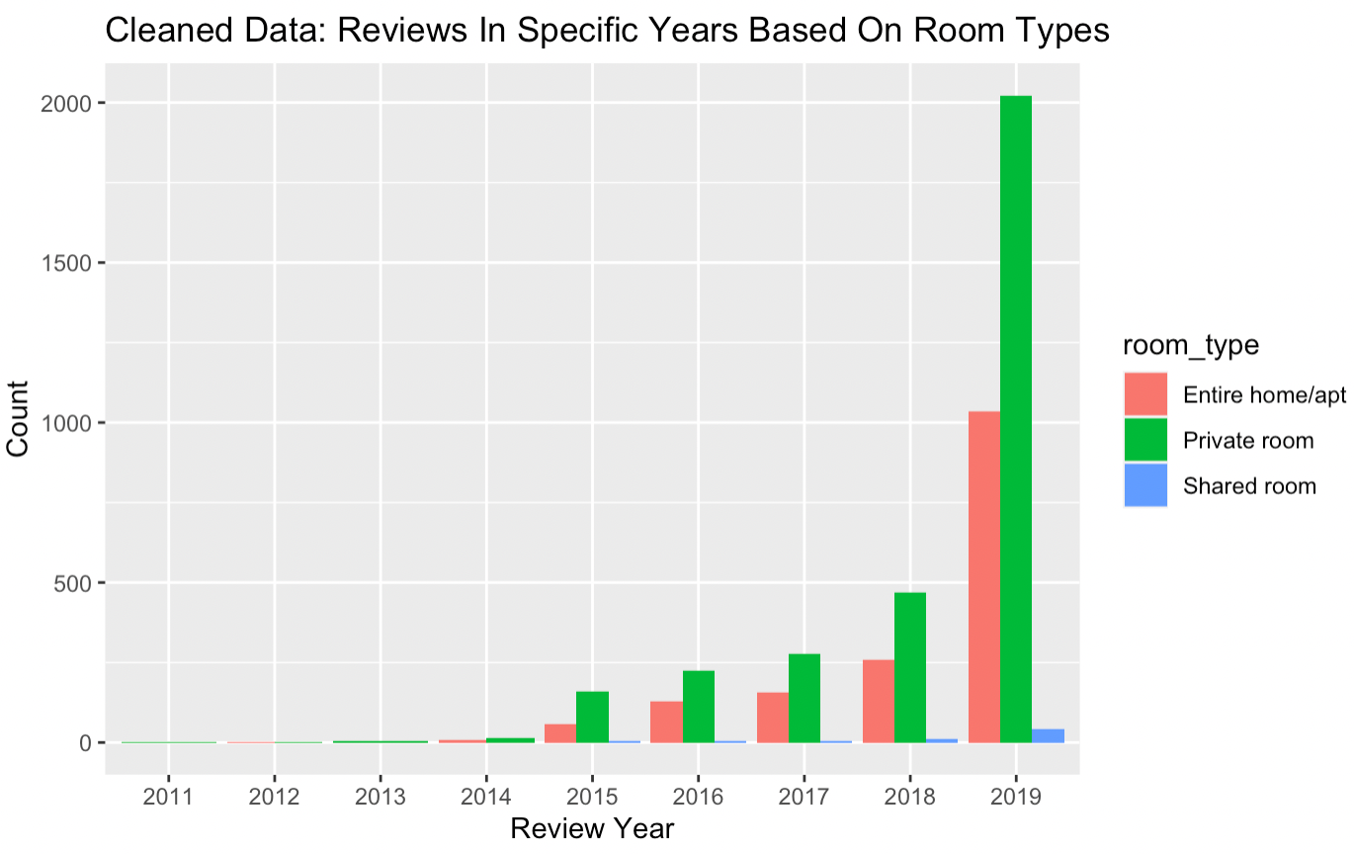
Reviews In Specific Years Based On Room Types From Year 2011-2019
Business Question:
What is the number of reviews for each room type from the year 2011 to 2019?
Analysis:
As per the given bar chart, we can clearly depict there is an exponential growth of the reviews received from year 2011-2019. Moreover, we see a huge jump of reviews received in 2019 as compared to the previous year 2018.
For the year 2011-2019, Private room were always in demand and there was an overflowing of reviews received from the customers as compared to other room types after 2015.
Reason:
Good hospitality service and corporate discounts.
Breakfast, parking, airport pickup/drop facility.
Better transport and infrastructure.

Slide 10
References
Data Visualization Tips For More Effective And Engaging Design. (n.d.). Tableau. Retrieved October 29, 2022, from https://www.tableau.com/learn/articles/data-visualization-tips
Descriptive Statistics and Graphics - Easy Guides - Wiki - STHDA. (n.d.). Retrieved October 29, 2022, from http://www.sthda.com/english/wiki/descriptive-statistics-and-graphics
Kervizic, J. (2021, December 13). Data Science Career Path & Progression - Hacking Analytics. Medium. https://medium.com/analytics-and-data/data-science-career-path-progression-ab5140cfbc84
Mapping in R: Latitude and Longitude Coordinates. (n.d.). Mapping in R. Retrieved October 29, 2022, from https://map-rfun.library.duke.edu/01_georeference.html
New York City Airbnb Open Data. (2019, August 12). Kaggle. https://www.kaggle.com/datasets/dgomonov/new-york-city-airbnb-open-data?resource=download
R in Action, Second Edition. (n.d.). Manning Publications. Retrieved October 29, 2022, from https://www.manning.com/books/r-in-action-second-edition

Slide 11


Any Questions

Slide 12
UML Diagrams
Structural
Sequence
Activity diagram
Use case diagram
Behavioral
Profile diagram
Package diagram
Class diagram
Deployment diagram
Object diagram
Communication diagram
Interaction overview diagram

